Slide 1
CS 5123: Cloud Computing and Distributed Systems Intro. To Apache Spark
Arunkumar Bagavathi
Department of Computer Science
Oklahoma State university

Slide 2
Limitations of MapReduce
Efficiency challenges in many iterative algorithms
Graph algorithms like PageRank and Travelling Salesman algorithm
ML algorithms like k-Means clustering, k-NN, and neural networks
Supports only batch processing
Intermediate disk read/write
Intermediate results are usable only once – in Reduce()
Dependent tasks cannot be parallelized
Difficult programming structure
Notes:
5. Say if there are 2 tasks – 2 MR jobs. Each tasks are independent at first. At some point task 2 require task 1 output

Slide 3
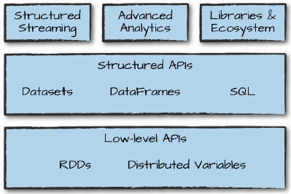
Apache Spark
Unified architecture – wide range of analytics tasks in a single framework
data loading
SQL queries
Machine learning
Streaming
Support configuring varied set of libraries for variety of tasks
Programming languages (Python, Java, Scala, and R)
Web applications (Node.js and Django)
Data storage (AWS S3, HDFS, Apache Kafka)
Analytics (Spark MLlib, Spark SQL, and Spark GraphX)
Deployment
Standalone
Amazon EC2
Hadoop YARN
Kubernetes
Source: Spark The Definitive Guide book

Slide 4
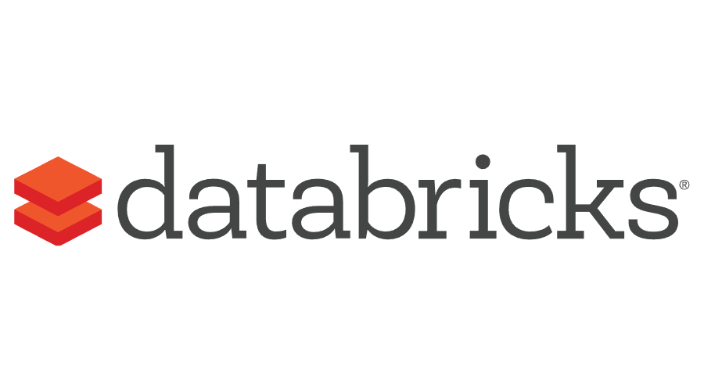


Spark Background
Developed by Dr. Matei Zaharia from Amplab at UC Berkeley
Written in Scala
First Published paper - 2011
Databricks extended support to Spark
Spark Summit started from 2013
to assemble scientists, analysts, and engineers
to give workshops on Spark, big data, data science, and machine learning
Enterprises using Spark at scale: Facebook, Hotels.com, Netflix, Microsoft, etc
Open source
Largest open source community in big data
1000s of contributors from 250+ organizations around the globe
Spark documentation: https://spark.apache.org/docs/2.0.0/
Spark 2.0 release video: https://www.youtube.com/watch?v=RUTeY4E2MoQ
Notes:
Why Scala? Better Java, more scalable, easy to integrate new features, faster than R and Python, functional + OOPS

Slide 5
Can we do better than MapReduce?
Major drawback in MapReduce with big data
More I/O than computation
Less flexible in programming
Can we reduce the I/O and improve flexibility?
Apache Spark tries to keep the intermediate data in memory instead of spilling it to the disk
Spark achieves this with Resilient Distributed Datasets (RDD)

Slide 6
Resilient Distributed Datasets (RDD)
RDD
data structure to store immutable collections of objects (Java, Scala, or Python) that can be distributed and processed in parallel in the cluster
Main component in Spark
User has a complete control over
Partitioning
Storage (Memory or disk)
Parallel operations on the data (transformations, and actions)
Fault tolerance

Slide 7
Resilient Distributed Datasets (RDD)
How to create RDD?
Loading the external dataset
Parallelizing local data structures: lists, dictionaries, etc.
Performing operations on existing RDDs
Basic operations in RDDs
Transformations
Actions

Slide 8
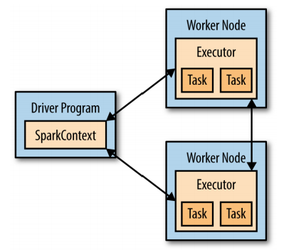
Spark Concepts
Spark follows primary-secondary node architecture
Every Spark job/application start with the Driver program
Driver
runs in a primary node
access Spark through SparkContext – builds RDDs
converts user application into smaller tasks
assign tasks to secondary nodes
schedules job execution
manages RDDs
Executor
execute tasks
read/write data
store intermediate results in-memory, cache, or on hard drives
Source: Learning Spark book

Slide 9
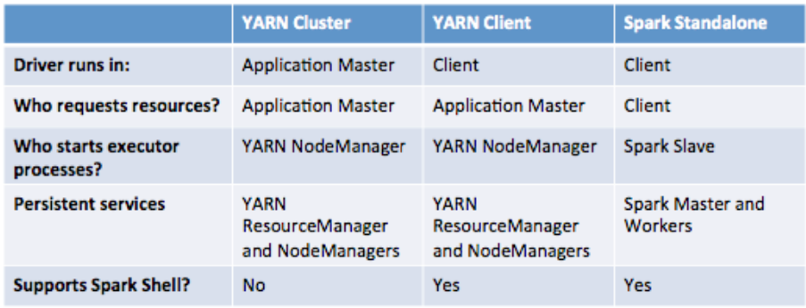
Spark Execution
Standalone application – created in Java/Python and runs in local machine (or) configured machines
YARN
Client
Cluster
User programs are same for all execution types

Slide 10
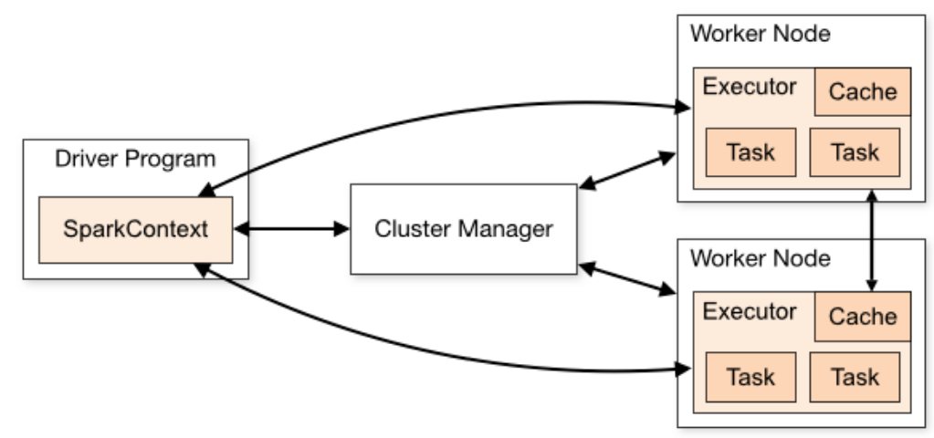
Spark Standalone Execution
Cluster Manager – acquire and allocating resources for tasks in the cluster
YARN is the cluster manager when the execution is in YARN mode
Works in both cluster and local setups

Slide 11
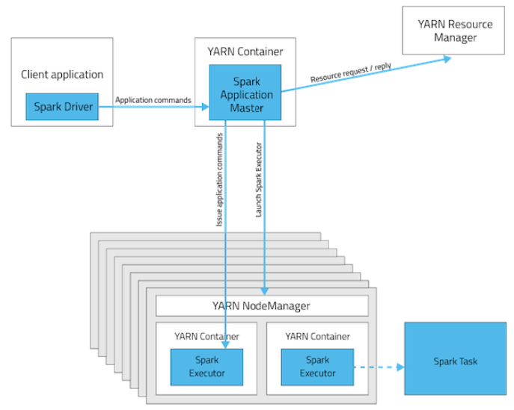
Spark Execution in YARN Client mode
Spark Driver runs on the Client side, where the job is submitted
Application Master requests resources from YARN
Client communicates with executors to schedule the tasks
No support for interactive execution
Source: Cloudera

Slide 12
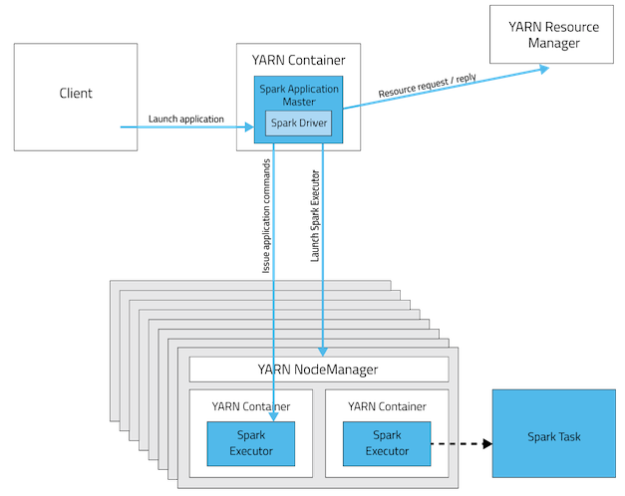
Spark Execution in YARN Cluster mode
Spark Driver runs in the Application Master of the cluster
Single node is responsible for running the Driver and requesting resources from YARN
Client launching the application doesn’t need to be active for the complete lifetime of the application
No support for interactive execution
Source: Cloudera

Slide 13
Spark Application Execution Overview
Initialize SparkContext and the application becomes a Driver
The Driver requests resources from the cluster manager to complete tasks
The cluster manager launches executors
Based on transformations and actions, the Driver send the tasks to executors
Executors run their corresponding tasks and output results as commanded (save in-memory or spill to disk for future use or write to disk)
If an executor crashes, Driver assign tasks other executors
If the Driver ends/crashes, all tasks will be terminated and all executor resources will be released

Slide 14
Simple RDD Creation Step (Scala)
Create SparkContext
val sc = new SparkContext()
Create RDD by reading file contents
val inputRDD = sc.textFile(filepath) ➔ Creates RDD[String]
Create RDD by parallelizing local data structures
val inputArray = Array(1,2,3,4,5,6)
val inputRDD = sc.parallelize(inputArray,2) ➔ Creates 2 partitions of RDD[Int]

Slide 15
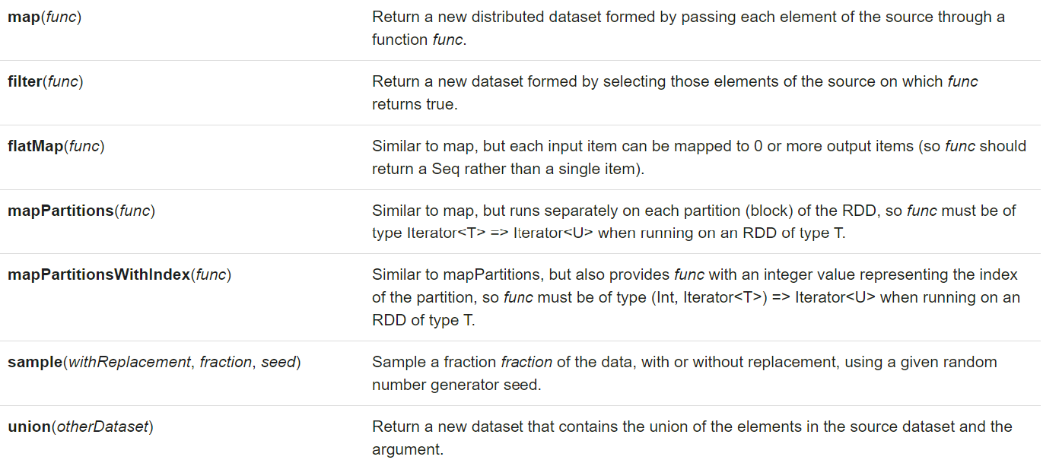
Spark Operations: Transformations
Transformations are performed when there is any need for computation over the RDD (data which is distributed over executors)
Transformations create a new RDD
Source: Spark documentation

Slide 16
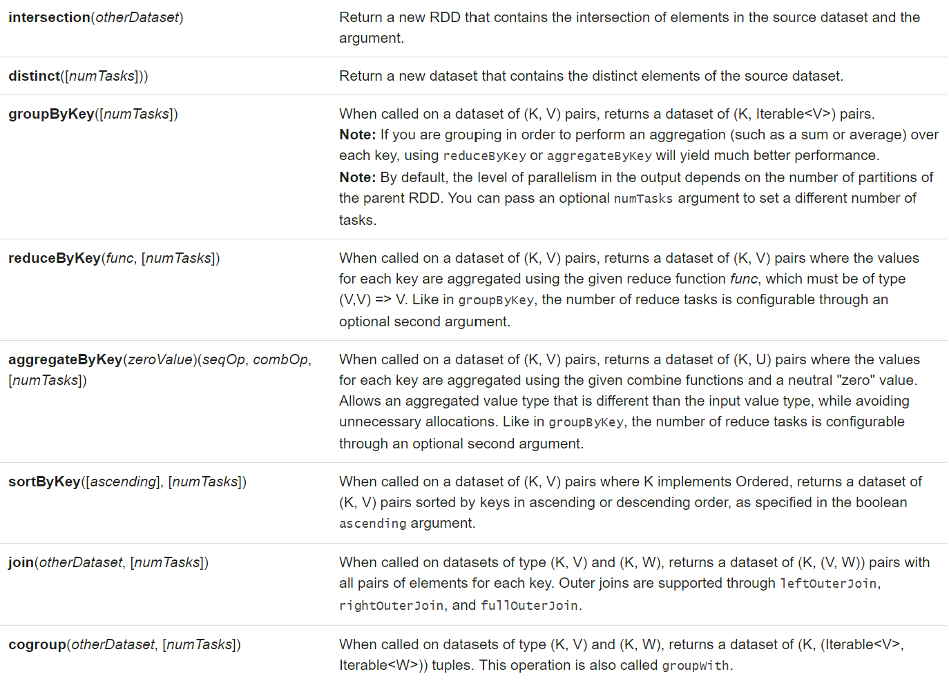
Spark Operations: Transformations
Source: Spark documentation

Slide 17
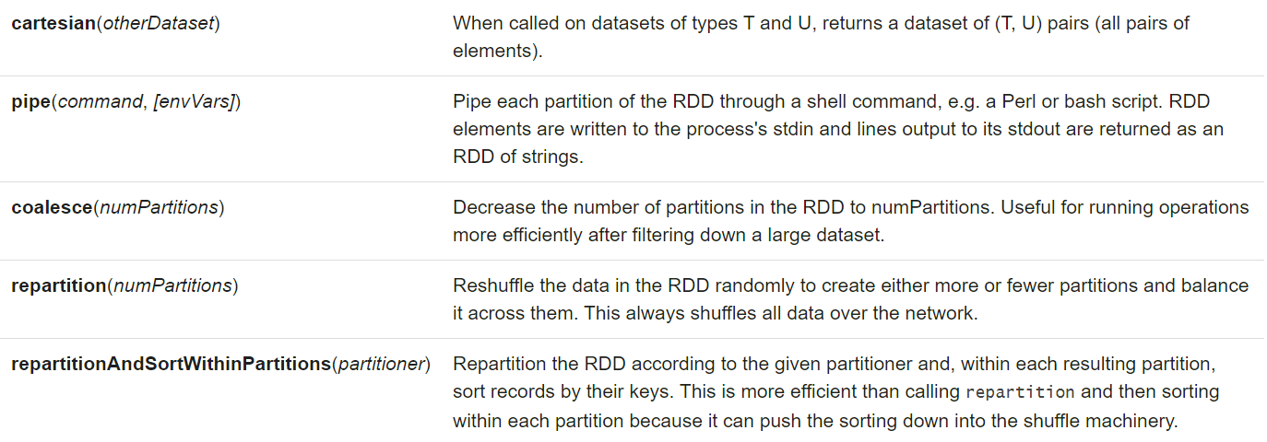
Spark Operations: Transformations
Source: Spark documentation

Slide 18
Spark Operations: Actions
Actions are usually performed for outputs
Write outputs to disk
Return outputs to the Driver
All intermediate results will cleared from executors’ memory
Running the same action operation will re-compute all transformation operations preceding it
This can be avoided by persisting an RDD in memory using persist() or cache()
It can be persisted on disks also

Slide 19
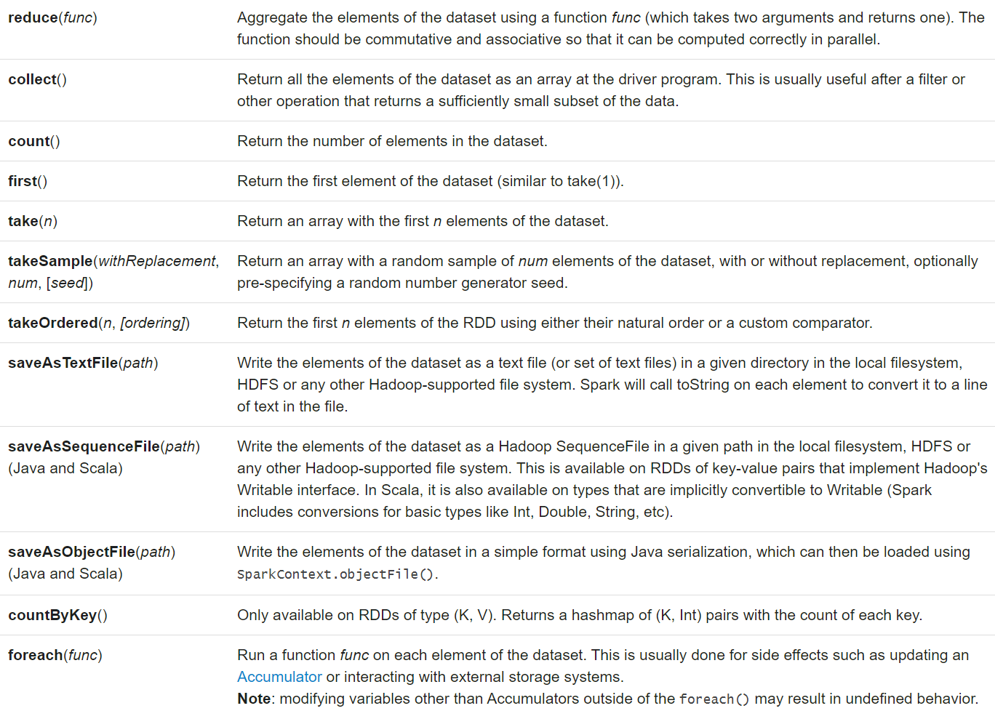
Spark Operations: Actions
Source: Spark documentation

Slide 20
Example Transformations
map(func) – takes each input from the data and applies a function (func)
Example:
val inputRDD = sc.textFile(input.txt)
mapRDD = inputRDD.map(s => s.toInt + 1)
mapPartitions(func) – similar to map(func), but runs on each partition of RDD. The func must accept Iterator as input and produce Iterator as output
Example:
val inputArray = Array(“one”,”two”,”three”,”four”,”five”)
val inputRDD = sc.parallelize(inputArray,2)
val mapRDD = inputRDD.mapPartitions(iterator => {
val l = iterator.toList
l.map(s => s + ”-”)
})
Notes:
How many output elements if there are 10 input elements?

Slide 21
Example Transformations
mapPartitionsWithIndex(func) – similar to map(func), but runs on each partition of RDD. The func must accept Iterator and Index as input and produce Iterator as output
Example:
val inputArray = Array(“one”,”two”,”three”,”four”,”five”)
val inputRDD = sc.parallelize(inputArray,2)
val mapRDD = inputRDD.mapPartitionsWithIndex((index,iterator) => {
val l = iterator.toList
l.map(s => s + ”-” + index).toIterator
})

Slide 22
Example Transformations
flatMap(func) – creates an RDD after executing func on each element of the input. Similar to map(), but flatMap allows to return 0 or more output elements. Thus the output type should be Iterator
flatMap() flattens the output
Example:
val inputRDD = sc.parallelize(filepath,2)
val mapRDD = inputRDD.flatMap(line => line.split(“ “))

Slide 23
Example Transformations
filter(func) – creates an RDD after executing filter func on each element of the input
Example:
val inputArray = Array(1,2,3,4,5,6,7,8)
val inputRDD = sc.parallelize(inputArray,2)
val mapRDD = inputRDD.filter(_ % 2 == 0)
var results = mapRDD.collect()

Slide 24
Example Transformations
groupByKey([numPartitions]) – works only for (K,V) pairs. Outputs <K,[V]>, which are grouped from all data partitions. Use this only to group values.
reduceByKey(func,[numPartitions]) – similar to groupByKey(), but applies a map(func) to the grouped values and outputs <K,V>
What is Key and Value?
Give Examples!
Check aggregateByKey() also

Slide 25
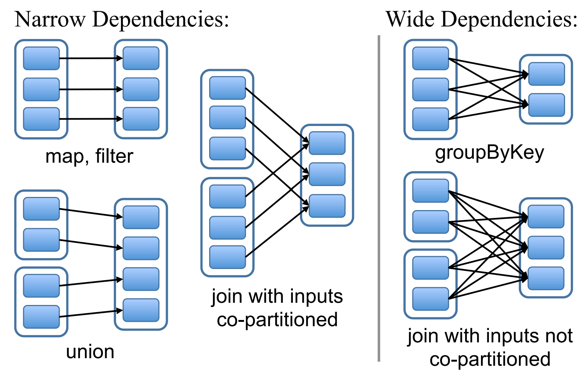
Spark Transformation Types
Narrow vs Wide transformations
Narrow transformations
Series of executions can be performed in a single node on element-by-element basis
Re-computation of lost partition in RDD is efficient
Wide transformations
Requires to collect data from parent partitions and shuffled across nodes like MapReduce
Failures in a node may cause large amount of re-execution
Source: Spark- Cluster Computing with Working Sets paper

Slide 26
Example Transformations
repartition()
increase/decrease the number of data partitions in RDD
full data shuffle happens
very expensive with big data
coalesce() – decrease the number of data partitions in RDD
optimized version of repartition()
reduces the movement of data

Slide 27
Example Actions
collect() – returns all elements from transformation(s) as an array to the Driver program
Do not use this for applications which return huge volumes of data!
count() – returns number of elements in transformation(s) output
first() – returns first element in RDD
take(n) – returns first ‘n’ elements in RDD
saveAsTextFile(filepath) – writes RDD elements as a text files in the filepath in local file system or HDFS (number of outputs!)

Slide 28
Spark Documentation
Check complete list of operation functions in: https://spark.apache.org/docs/latest/index.html

Slide 29
Example Spark Program: WordCount
Scala
Python
val inputRDD = sc.textFile(filepath)
val rdd1 = inputRDD.flatMap(line => line.split(“ “))
val rdd2 = rdd1.map(word => (word,1))
val rdd3 = rdd2.reduceByKey(_ + _)
rdd3.saveAsTextFile(filepath2)
inputRDD = sc.textFile(filepath)
rdd1 = inputRDD.flatMap(lambda line: line.split(“ “))
rdd2 = rdd1.map(lambda word: (word,1))
rdd3 = rdd2.reduceByKey(lambda a, b: a + b)
rdd3.saveAsTextFile(filepath2)

Slide 30
Lazy Transformations
val inputRDD = sc.textFile(filepath)
val rdd1 = inputRDD.flatMap(line => line.split(“ “))
val rdd2 = rdd1.map(word => (word,1))
val rdd3 = rdd2.reduceByKey(_ + _)
val rdd4 = rdd1.map(word => word + “-”)
rdd3.saveAsTextFile(filepath2)
What is the order of execution?
All transformations in Spark are lazy.
Notes:
Explain what will be the performance after an Action()

Slide 31
Spark Execution Overview
Executor
Block 1
val inputRDD = sc.textFile(filepath)
val rdd1 = inputRDD.flatMap(line => line.split(“ “))
val rdd2 = rdd1.map(word => (word,1))
val rdd3 = rdd2.reduceByKey(_ + _)
rdd3.saveAsTextFile(filepath2)
Driver
Process & Cache data
Executor
Block 2
Executor
Process & Cache data
Block 3
Process & Cache data

Slide 32
Spark Execution Overview
Cache
Executor
Results
Block 1
val inputRDD = sc.textFile(filepath)
val rdd1 = inputRDD.flatMap(line => line.split(“ “))
val rdd2 = rdd1.map(word => (word,1))
val rdd3 = rdd2.reduceByKey(_ + _)
rdd3.count()
Driver
Results
Cache
Executor
Results
Block 2
Cache
Executor
Block 3
How Spark remember the steps?
Directed Acyclic Graph (DAG)

Slide 33
Spark Fault Tolerance – DAG (1)
Also called lineage graphs
Spark framework creates a Directed Acyclic Graph of operations from the user written program
This graph represents a physical execution plan for the Driver
DAGs help Spark to break an application into tasks
Once Action is reached, the graph is translated into execution and tasks are assigned to nodes in the cluster
DB read
File read
RDD-1
RDD-2
RDD-3
join
RDD-4
map
RDD-5
filter

Slide 34
Spark Fault Tolerance – DAG (2)
File read
DB read
Spark handles fault tolerance with the help of DAGs
DAGs help to backtrack lineage in case of any failures in between operations
Example
Consider RDD is lost due to the worker node failure
Spark uses DAG to backtrack and recompute the RDD
RDD-1
RDD-2
RDD-3
join
RDD-4
map
RDD-5
filter
Notes:
Consider the map() RDD is lost after its computation. Spark just recomputes the map() results instead of the complete operation

Slide 35
Spark Data Partitioning
Collection of data partitions is called RDD. A data partition does not span across nodes
Each node can have more than one data partitions
Number of partitions is configurable. Having too many or too few is not good
Configuring partitions is useful when a data is used multiple times in key-oriented operations like join()
Why partitioning? Minimize network traffic between operations. Unpartitioned data creates lot of data shuffling in transformations like: leftOuterJoin(), groupByKey(), reduceByKey(), and lookup
Types of partitions: HashPartitioner, RangePartitioner,and CustomPartitioner

Slide 36
Spark Execution Overview
Cache
Executor
Block 1
val inputRDD = sc.textFile(filepath)
val rdd1 = inputRDD.flatMap(line => line.split(“ “))
val rdd2 = rdd1.map(word => (word,1))
val rdd3 = rdd2.reduceByKey(_ + _)
rdd3.saveAsTextFile(filepath2)
What happens when the following appears after file save?
val rdd4 = rdd1.map(word => word + ”-”)
rdd4.count()
Driver
Process & Cache data
Cache
Executor
Block 2
Cache
Executor
Process & Cache data
Block 3
Process & Cache data
These jobs are sequential!

Slide 37
Spark Data Persistence
In some applications same RDD should be used multiple times without recomputing it
3 types of RDD persistence
In-memory deserialized object – used for faster performance but memory inefficient
In-memory serialized object – used for memory efficient storage but lower performance
On-disk – used when the RDD is too large to be persisted in memory
Spark’s Least Recently Used (LRU) policy
Spark evicts least recently used RDD from memory
Such RDD must recomputed again if necessary

Slide 38
Shared Variables
Driver{
var count = 1
count = count + 2
tasks
println(count)
}
RDD.map(line => {
count = /*What will be the ‘count’ value here???*/
count = count + 2
})
Variable defined in driver can be used in tasks
But each task gets their own copy of the variable
Updates made in tasks will not be propagated to Driver
Types of shared variables in Spark
Accumulators
Broadcast variables

Slide 39
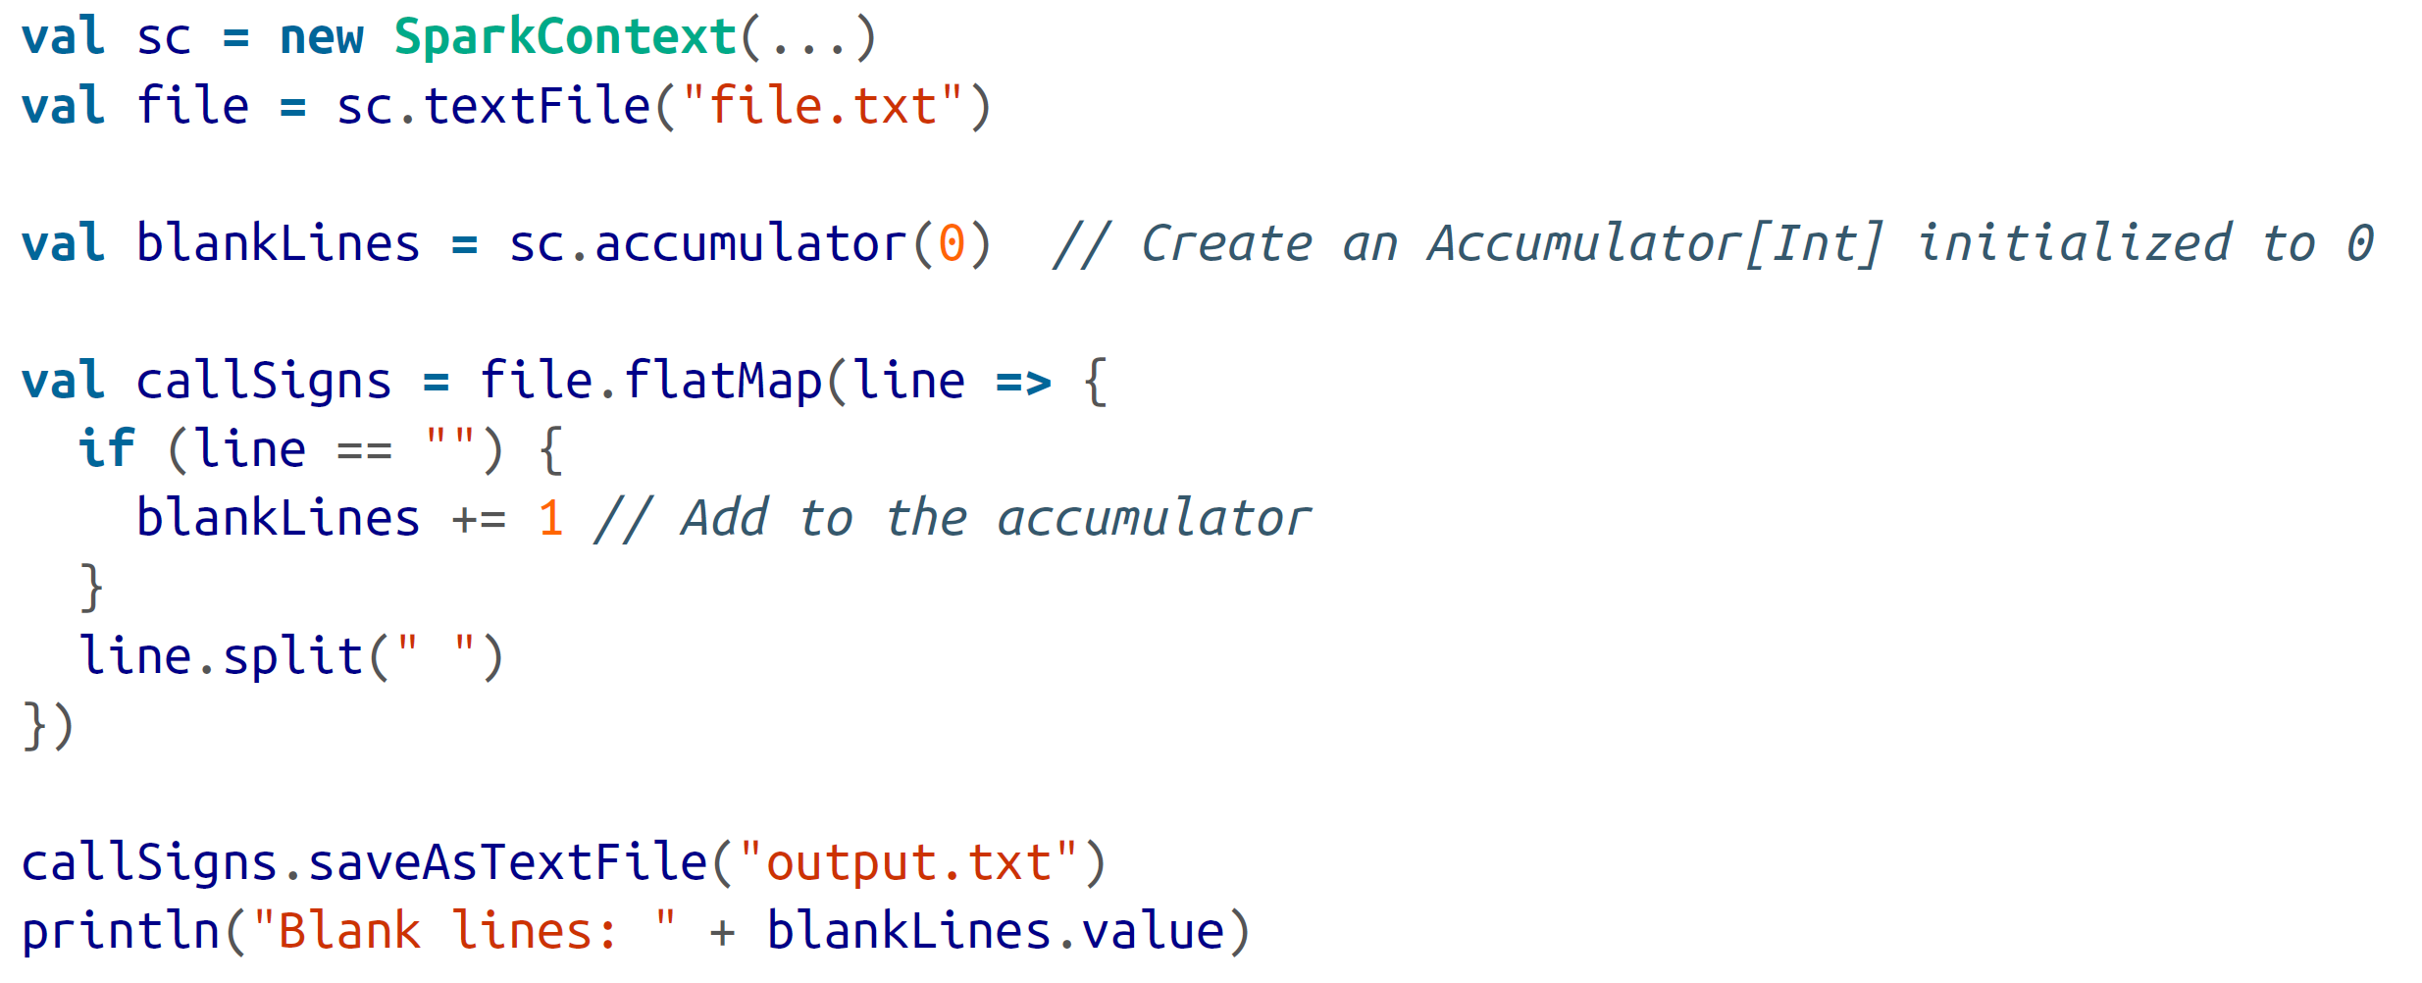
Shared Variables: Accumulators
Accumulators are used to aggregate values from tasks to the Driver
Example: Counting empty lines in the word count program
Accumulators are update-only for tasks
Source: Learning Spark book

Slide 40
Shared Variables: Broadcast variables
Broadcast variables are used to send large read-only data to all executors
But sending large data to the cluster nodes can be inefficient
Thus we wrap the data object to a serialized object called spark.broadcast.Broadcast[T], where T is the type of data that we want to broadcast
Broadcast variables can be accessed using value() in worker nodes
These values can be updated in worker nodes, but that will not reflect in Driver or other worker nodes
Source: Learning Spark book

Slide 41
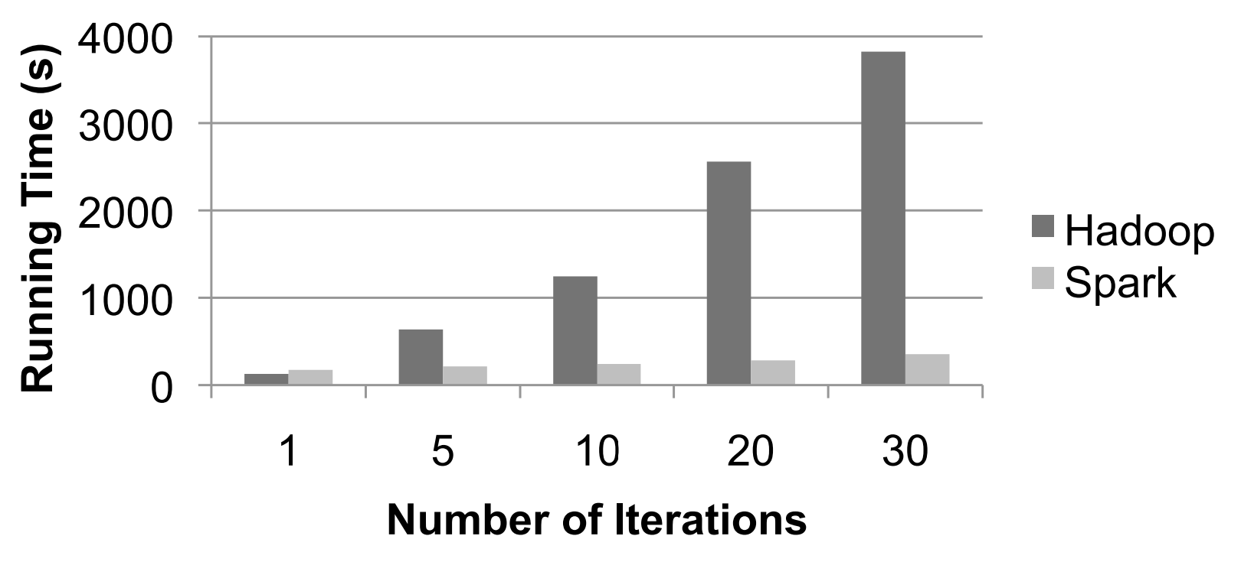
Spark Performance comparison
Performance comparison for Logistic Regression
Source: Spark- Cluster Computing with Working Sets paper

Slide 42
Conclusion
Spark is a powerful tool to perform advanced data analytics
It provides all facilities (graph computation, ML, and SQL) in one framework
Fault tolerant
Easy to use
Easy to adapt
Fast processing of big data

Slide 43

Questions???

Slide 44
Acknowledgements
Some contents of these slides are motivated by materials from:
Dr. Srinivas Akella – UNC Charlotte
Spark: The Definitive Guide textbook by Chambers, and Zaharia
Learning Spark: Lightning-Fast Data Analysis textbook by Karau, Konwinski, Wendall, and Zaharia
spark.apache.org
Zaharia, Matei, et al. "Spark: Cluster computing with working sets." HotCloud 10.10-10 (2010): 95. (Paper)
Zaharia, Matei, et al. "Resilient distributed datasets: A fault-tolerant abstraction for in-memory cluster computing." Presented as part of the 9th {USENIX} Symposium on Networked Systems Design and Implementation ({NSDI} 12). 2012. (Paper)

